Slide 1

IMDB DATASET
SQL REINFORECEMENT PROJECT
GURUPRASATH K
DA & DS OCTOBER BATCH
07-01-2025

Slide 2
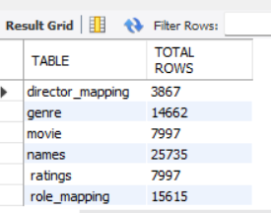
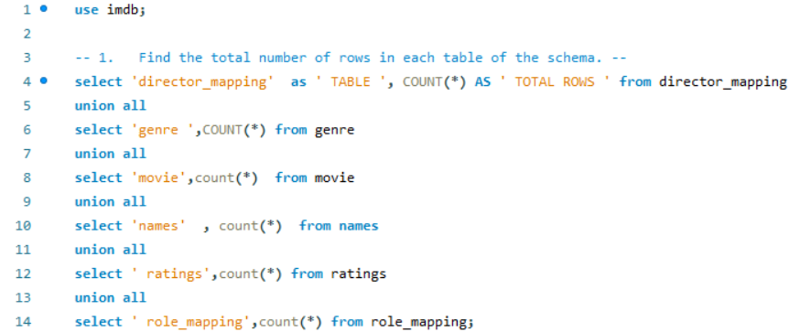
1.Find the total number of rows in each table of the schema.

Slide 3
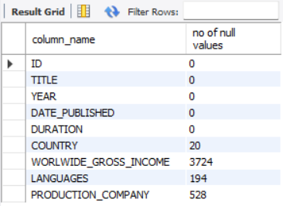
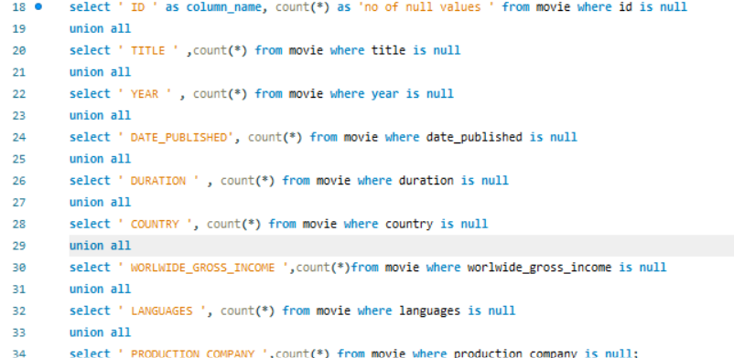
2.Which columns in the movie table have null values?

Slide 4
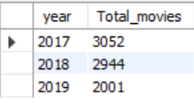
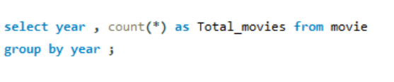
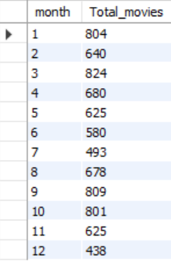
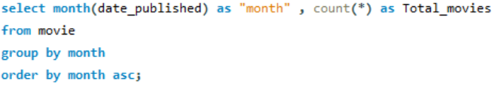
3.Find the total number of movies released each year. How does the trend look month-wise?

Slide 5
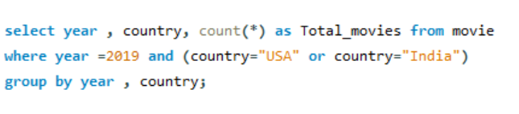
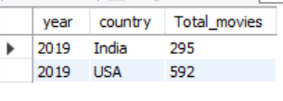
4.How many movies were produced in the USA or India in the year 2019?

Slide 6
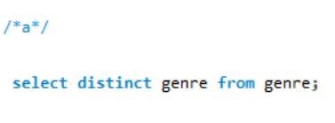
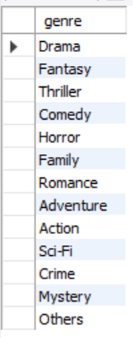
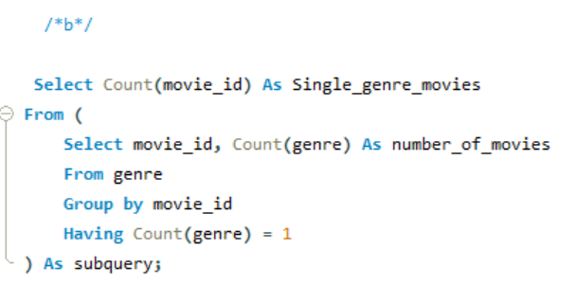

5.Find the unique list of genres present in the dataset and how many movies belong to only one genre.

Slide 7
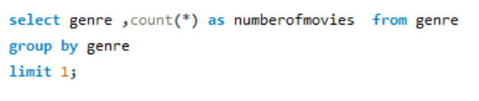

6.Which genre had the highest number of movies produced overall?

Slide 8
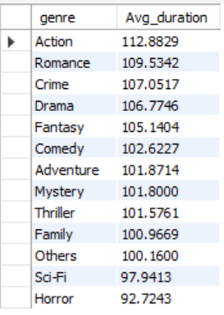
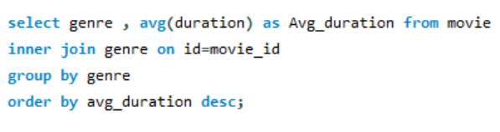
7.What is the average duration of movies in each genre?

Slide 9
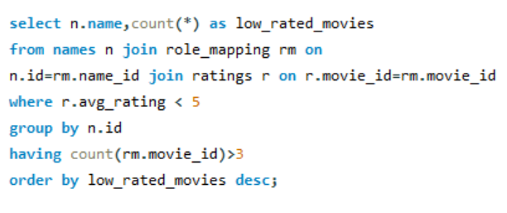
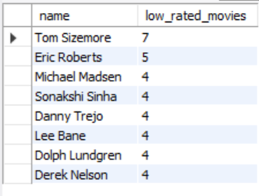
8.Identify actors or actresses who have worked in more than three movies with an average rating below 5?

Slide 10
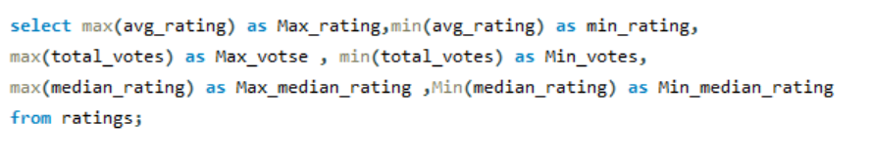

9.Find the minimum and maximum values in each column of the ratings table except the movie_id column.

Slide 11
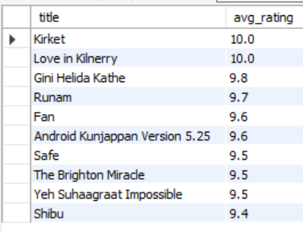
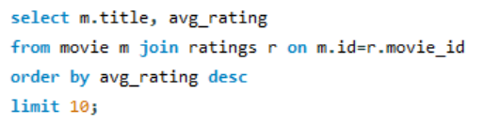
10.Which are the top 10 movies based on average rating?

Slide 12
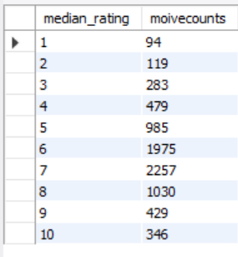
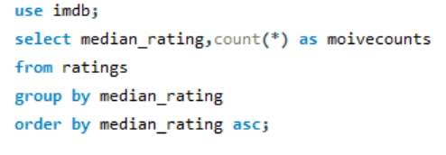
11.Summarise the ratings table based on the movie counts by median ratings.

Slide 13
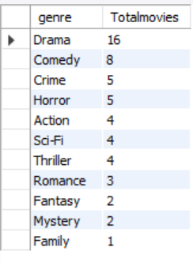
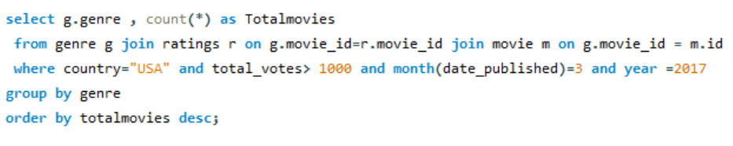
12.How many movies released in each genre during March 2017 in the USA had more than 1,000 votes?

Slide 14
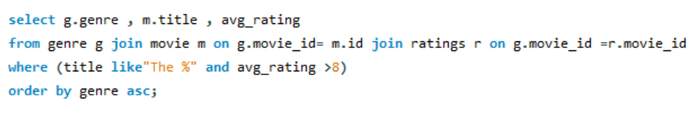
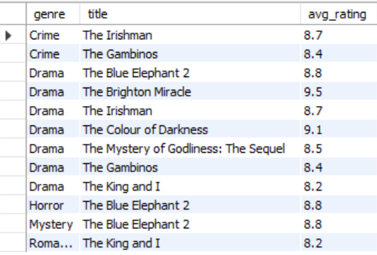
13.Find movies of each genre that start with the word ‘The ’ and which have an average rating > =8.

Slide 15
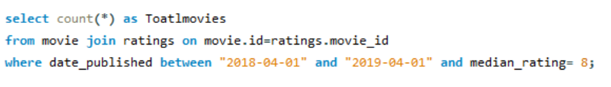

14.Of the movies released between 1 April 2018 and 1 April 2019, how many were given a median rating of 8?

Slide 16
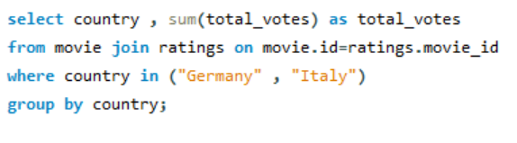
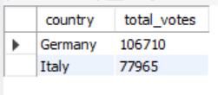
15.Do German movies get more votes than Italian movies?

Slide 17
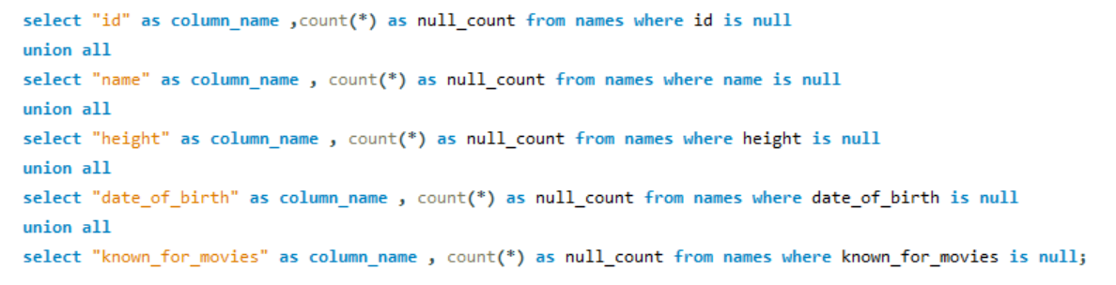
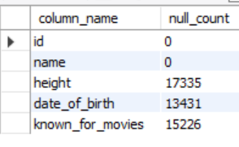
16.Which columns in the names table have null values?

Slide 18
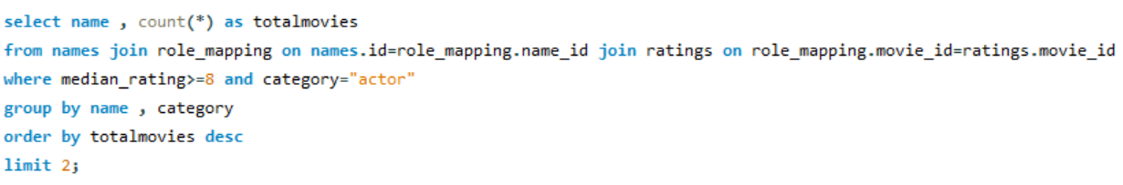
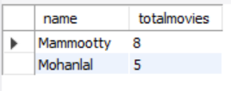
17.Who are the top two actors whose movies have a median rating >= 8?

Slide 19
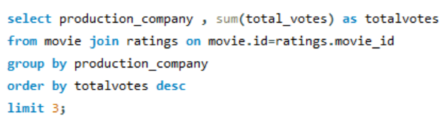
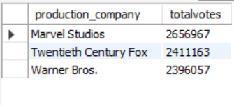
18.Which are the top three production houses based on the number of votes received by their movies?

Slide 20
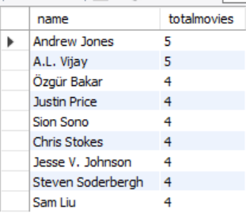
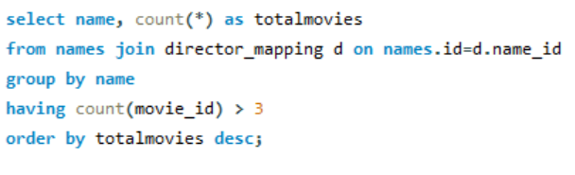
19.How many directors worked on more than three movies?

Slide 21
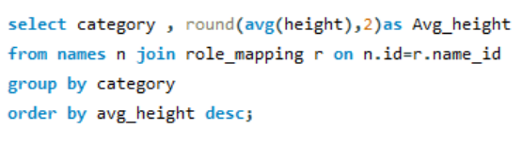
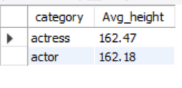
20.Find the average height of actors and actresses separately

Slide 22
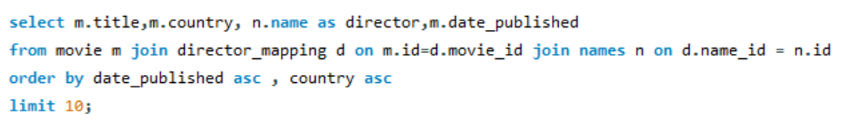
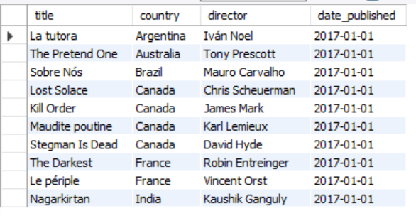
21.Identify the 10 oldest movies in the dataset along with its title, country, and director.

Slide 23
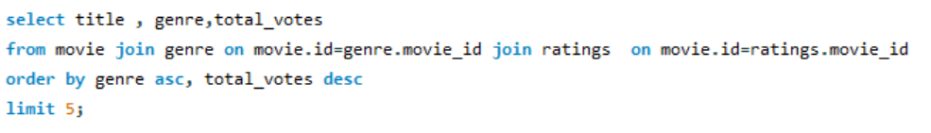
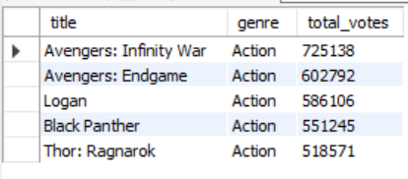
22.List the top 5 movies with the highest total votes and their genres.

Slide 24
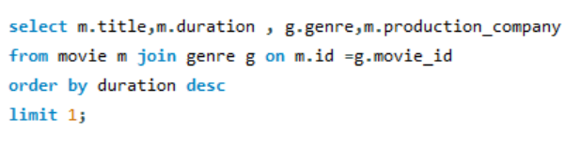

23.Find the movie with the longest duration, along with its genre and production company.

Slide 25
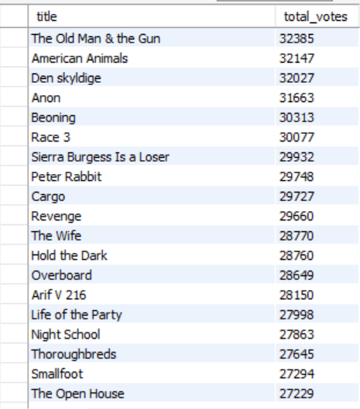
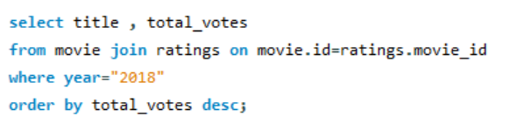
24.Determine the total votes received for each movie released in 2018.

Slide 26
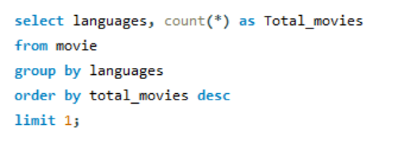

25.Find the most common language in which movies were produced.

Slide 27
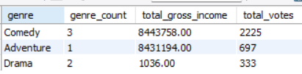
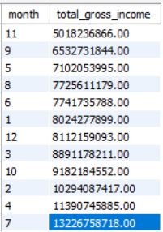
Insights
INSIGHTS
COUNTRY - PERU, USA
Less Gross Income in Genre “Drama”
Top Month’s in Gross Income

Slide 28

THANK YOU
THANK YOU

